Slide 1
Supporting student requests for accommodations on USMLE exams
Neera R. Jain, MS, CRC
University of California, San Francisco
Lisa M. Meeks, PhD
University of California, San Francisco
School of Medicine
Jayme Bograd
AAMC
The presenters’ views and opinions are their own and do not necessarily reflect the position of the AAMC.

Slide 2
The Coalition and the UCSF School of Medicine wish to thank the AAMC for their generous support in developing this webinar series.

Slide 3
Overview
Request process: USMLE Step 1, 2 CK and CS
Documentation requirements
Advising students about the process
Developing a timeline
Developing strong personal statements
Writing an effective letter of support
Supporting students through a reconsideration (appeal)

Slide 4
Request Process
Request is made directly to NBME Disability Services
  http://www.usmle.org/test-accommodations/
  Review Guidelines for applications
Submit a request form, personal statement, documentation, “Certification of Prior Test Accommodations,” and other supporting material, MCAT scores (regardless of accommodation status)
  Separate forms for new and subsequent requests
Acknowledgement of receipt within several business days by email
Decision process takes 60-90 days (currently running up to 120)
Reconsideration (appeal) of denial may take 60+ days

Slide 5
Documentation Requirements
“A detailed, comprehensive written report describing your disability and its severity and justifying the need for the requested accommodations.”
General criteria, as well as specific requirements for learning disability, AD/HD, vision and hearing disability documentation are provided
Currency: generally within 3 years
For those without prior accommodation history:
  Documentation should address reason why (e.g., new dx, lack of funds to receive testing, etc.)
  Additional statements of support

Slide 6
Determining Eligibility
Evidence of physical or mental Impairment
Substantially limits major life activity
Rises to the level of requiring accommodations
School
Work
Daily living
Social

Slide 7
Understanding Exam and Needs
Accommodations
Time
Breaks
AT
Private Room
Communication Aids
Personal Items
Format
Length
Computer/Paper
Scrap Paper
Patient Interaction
Announcements
Phone Scenarios

Slide 8
What Should Students Expect?
Delays in the process
“Holding pattern” during accommodation review
  Cannot register for exam
  Cannot access online practice exam
Submit recent, detailed documentation
  Update documentation if needed
Locate multiple centers for accommodated testing
Make requests for any personal item exceptions not on the pre-approved list

Slide 9

Start as soon as they walk in the door

Slide 10
Why Start Early?
2nd year gets hectic
Putting off application causes stress
Historical information gathering takes time
Process of applying takes up to 10 months
Potential waitlist for evaluators
Limited free time
Cost of assessments
Psychological impact of writing the personal statement
Revisions for personal statement (2-3)
Collecting letters of support

Slide 11
Building a Strong Argument
Student has a disability
There is a disability-related barrier to accessing the exam
Accommodations will allow for an accurate assessment of student’s knowledge

Slide 12
How You Can Support
Work with students to begin a file of historical documentation at the DS office
Evaluate documentation with an eye to NBME requirements
Set an ideal timeline for students to begin working on their application… send reminders
Be available to review drafts of personal statements and answer any questions
Write a strong letter of support

Slide 13
Establish an Ideal Timeline
10 months before: gather materials, determine if new documentation is needed
8 months before: personal statement
6 months before: review and finalize materials
4 months before: send in application (latest!)
Decision will take 60-90+ days
Appeal may take another 60 days
See sample timeline in book

Slide 14
The Personal Statement
Only opportunity to tell their story
Explain the nature of their disability and why they are requesting accommodations.
Focus on their areas of difficulty rather than strengths.
Emphasize the need for the accommodation rather than a preference.
Pay close attention to the language they use to describe their needs.

Slide 15
Language Matters
Students should be intentional about their word choice and avoid these common pitfalls
  I would appreciate it if…..
  It would be helpful to have….
Instead: I require....
“Throughout my education, x has allowed me to demonstrate my understanding of material on exams. I will requre the same accommodation for the USMLE”

Slide 16
Academic Program Letter of Support
“Certification of Prior Test Accommodations” to document accommodations provided in medical school
  “Reason(s) for accommodations:”
Add value to the other materials
  Observations, how your determined approved accommodations
Critical that these letters are individualized

Slide 17
Academic Program Letter of Support
Section 1:
  Who you are and your expertise
Section 2:
  Services and accommodations used at your institution
Section 3:
  The case for accommodations on this exam
Section 4:
  Provide any final information that is additive to the student’s request

Slide 18
Additional Support Items
Letters from:
  Advisors
  Faculty
  Deans
  DS providers
  K-12 or undergraduate educators, counselors
  Employer
Report cards (especially qualitative comments)
Previous test scores

Slide 19
Reconsideration (Appeal)
Students must speak to their case manager at NBME to get information about the process
Note the deadline for appeal
Read the denial letter carefully – what is the reasoning?
Students should seek assistance as soon as possible
Support the student to fill in the holes – write a letter
Use DOJ publication “ADA Technical Assistance: Testing Accommodations” to support the appeal
  www.ada.gov/regs2014/testing_accommodations.html

Slide 20
Reference
This presentation is informed by:
Jain, N. R., Lewis, C., Meeks, L. M. & Tucker, T.H. (2015). Requesting Accommodations on Standardized Exams. In L.M. Meeks & N.R. Jain (Eds.). The Guide to Assisting Students With Disabilities: Equal Access in Health Science and Professional Education (pp. 89-113). New York, NY: Springer Publishing.
Where indicated, handouts are copyrighted material from this chapter, provided for educational purposes.

Slide 21
Questions?

Slide 22
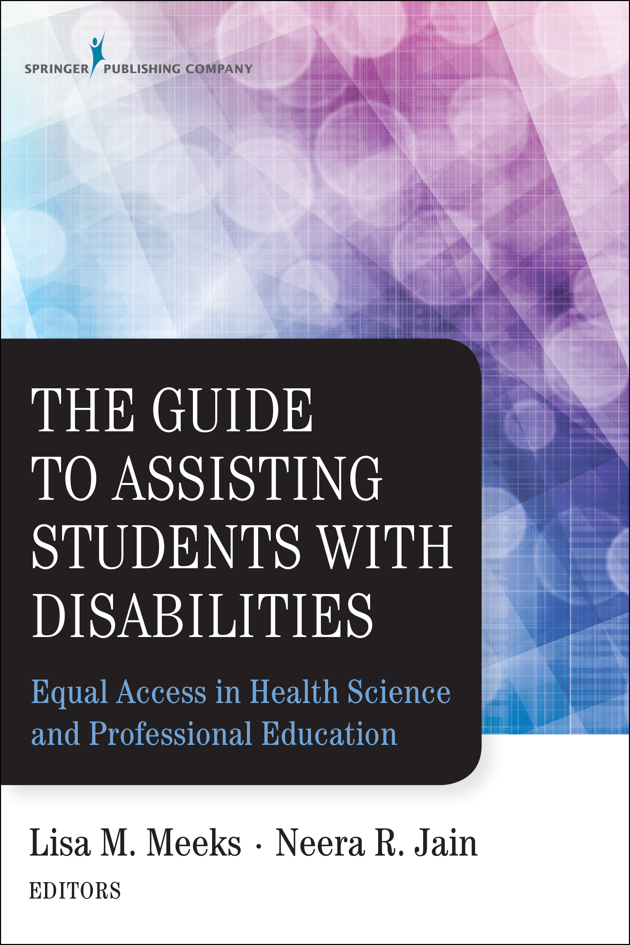
Resources
To join the Coalition & Listserv contact:
Grace Clifford at grace.clifford@case.edu
For more information on the Coalition go to:
http://meded.ucsf.edu/msds/coalition
To order the book visit:
Save 20%
www.springerpub.com
Promo code: AF1504

Slide 23
Stay tuned for forthcoming webinars.
Details and Registration:
www.aamc.org/gsa

